Slide 1
SEMANTIC BLOCKCHAIN System Architecture
Mentor:
Prof. Dr. Maria-Esther Vidal
Team Members:
Firas, Ernane, Matthew

Slide 2
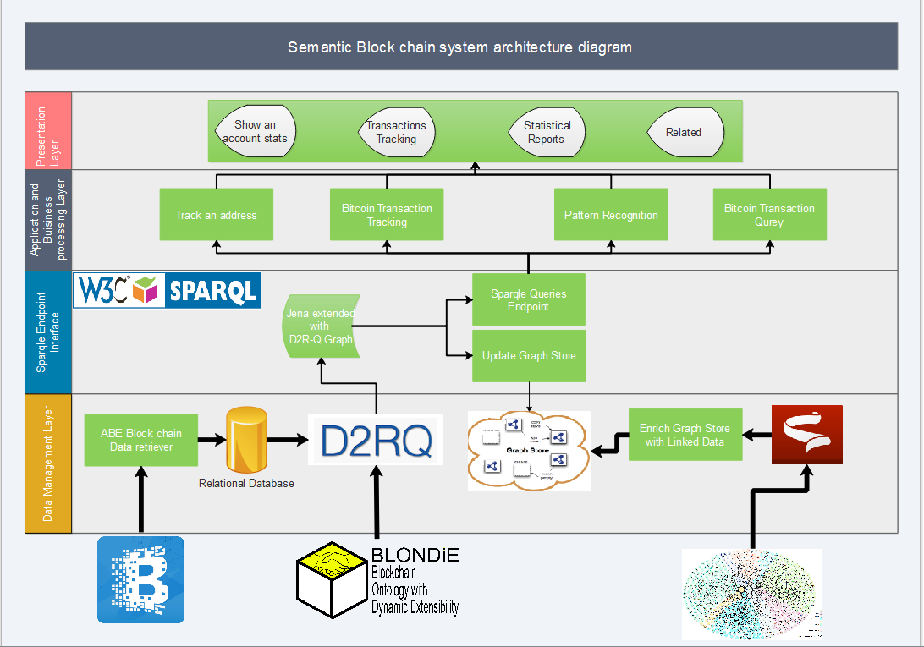

Slide 3
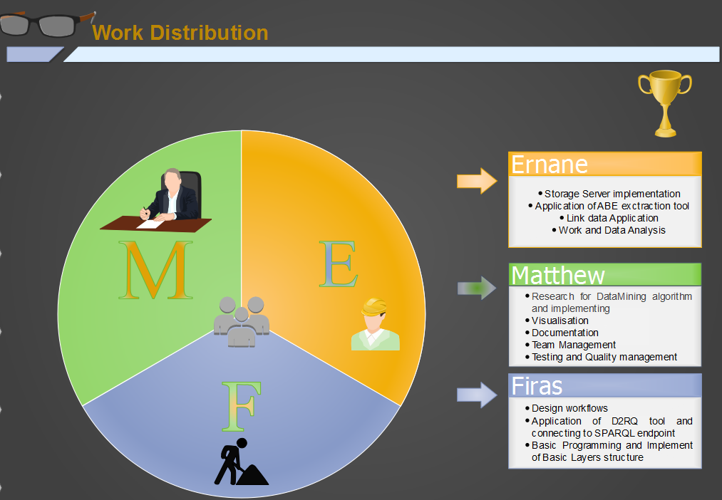

Slide 4
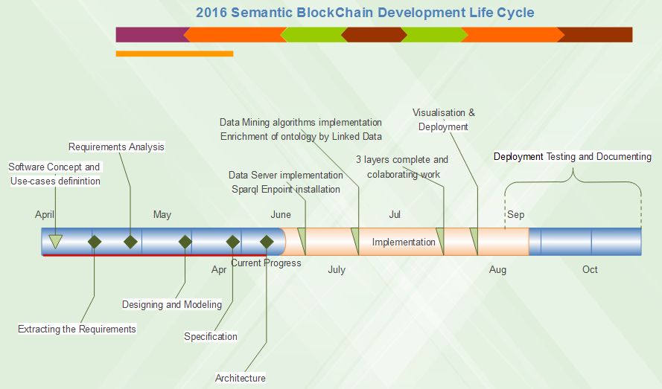

Slide 5

Best Poster Award
“ Semantic BlockChain”

